Slide 1
Computer Vision: Paradigms and Applications
Architectures, Pipelines, and Industry Impact
Group XII
Notes:
Good morning, Dr. Aleburu and fellow students. We are Group 12. Today, we’re presenting 'Computer Vision: Paradigms and Applications'. Our goal is to move beyond the surface and look at the actual architectures and pipelines that allow machines to impact industries like healthcare and transport today.

Slide 2
Agenda
Introduction and Foundations
Historical and Technological Evolution
Core Architectures and Operational Pipeline
State-of-the-Art and Applications
Challenges, Ethics, and Conclusion
Notes:
We’ve structured our talk into five key areas: we'll start with the foundations, move through the historical evolution that led to the Deep Learning revolution, dive deep into CNN and Transformer architectures, look at real-world applications, and finally, address the critical ethical challenges we face

Slide 3
Introduction and Foundations

Slide 4


What is Computer Vision?
The Definition
Computer Vision (CV) is the field of Artificial Intelligence that trains computers to interpret and understand the visual world. By using digital images from cameras and videos, machines can accurately identify, track, and react to objects.
The Mechanism
Unlike human vision which is innate, CV relies on Computational Methods, Sensors, and Mathematical Foundations like Linear Algebra and Calculus to process grid-like pixel data.
The Goal
The ultimate objective is to enable machines to perform Scene Interpretation, which involves understanding spatial relationships and context to make autonomous decisions
Notes:
Again, I am Raphael Fulfilled, and I'm joined by my colleagues Ajayi, Oluwadare, Orilade, and Iyanda. This presentation is the culmination of our research for the Special Topics in Computer Science course."

Slide 5

Core Objectives
Image Understanding
Teaching computers to perceive and interpret visual data
Feature Recognition
Identifying and extracting important patterns from images
Object Detection & Recognition
Locating and classifying objects in images
Notes:
At its core, Computer Vision is about bridging the gap between biological and machine sight. While we see naturally, machines require sensors and complex algorithms to achieve objectives like image understanding and scene interpretation—which is the ability to understand how objects relate to each other in space

Slide 6
Computer Vision vs. Related Fields
Image Processing: Enhancing Visual Quality
Focuses on ﬁltering, de-noising, and basic adjustments
Image Analysis: Quantitative Insights
Extracts measurements and statistical data from images
Machine Vision: Industrial Automation
Tailored for inspection and quality control in factories
Computer Vision: High-Level Interpretation
Enables machines to understand and reason about visual scenes
Notes:
It's vital to distinguish these fields. Image Processing is low-level; it’s about improving an image through denoising or filtering. Machine Vision is application-specific for factories. Computer Vision, however, is high-level; it’s the 'brain' that allows a machine to reason about a visual scene

Slide 7
Historical and Technological Evolution

Slide 8
Historical Evolution: 1950s to 2012
1958:
Perceptron
First neural network for pattern recognition
1966: MIT
Summer Vision Project
Ambitious attempt at a complete vision system
1974: Optical Character Recognition
Automated reading of printed text
1980:
Neocognitron
Hierarchical neural network for visual patterns
2001:
Viola-Jones Algorithm
Enabled real-time face detection
Notes:
Our journey began in 1958 with the Perceptron, the first neural network for pattern recognition. We saw the OCR breakthroughs in the 70s and the hierarchical Neocognitron in the 80s. A major milestone was the 2001 Viola-Jones algorithm, which was the first to make face detection work in real-time on standard hardware

Slide 9
The Deep Learning Revolution
2012: AlexNet Ignites Deep Learning
Breakthrough in image classiﬁcation with deep CNNs
2015: ResNet Enables Ultra-Deep Networks
152-layer architecture solves vanishing gradients
Present: Superhuman Visual Accuracy
Modern models surpass human benchmarks in vision
2017: Vision Transformers Emerge
Self-attention brings global context to vision tasks
Notes:
The era we live in now started in 2012 when AlexNet used Deep CNNs to shatter previous accuracy records. By 2015, ResNet solved the 'vanishing gradient' problem, allowing us to build networks 152 layers deep. Today, models have reached superhuman accuracy in many benchmarks

Slide 10
Core Architectures and Operational Pipeline

Slide 11
The 6-Step Operational Pipeline
Pre-processing & Feature Extraction
Noise reduction, normalization, and edge/corner detection
Feature Description & Matching:
Reﬁning outputs for ﬁnal interpretation or action
Post-Processing
Morphological operations and final actions
Image Acquisition
Collecting images or video from cameras and sensors
Feature Description & Pattern Recognition
Mapping features mathematically and classifying patterns
Pattern Recognition
Classifying data using CNNs or ML
Notes:
Technically, vision happens in six steps. It starts with Acquisition and Pre-processing to clean the data. We then detect features like edges and map them mathematically. This leads to Pattern Recognition using CNNs and finally Post-processing to refine the action.

Slide 12
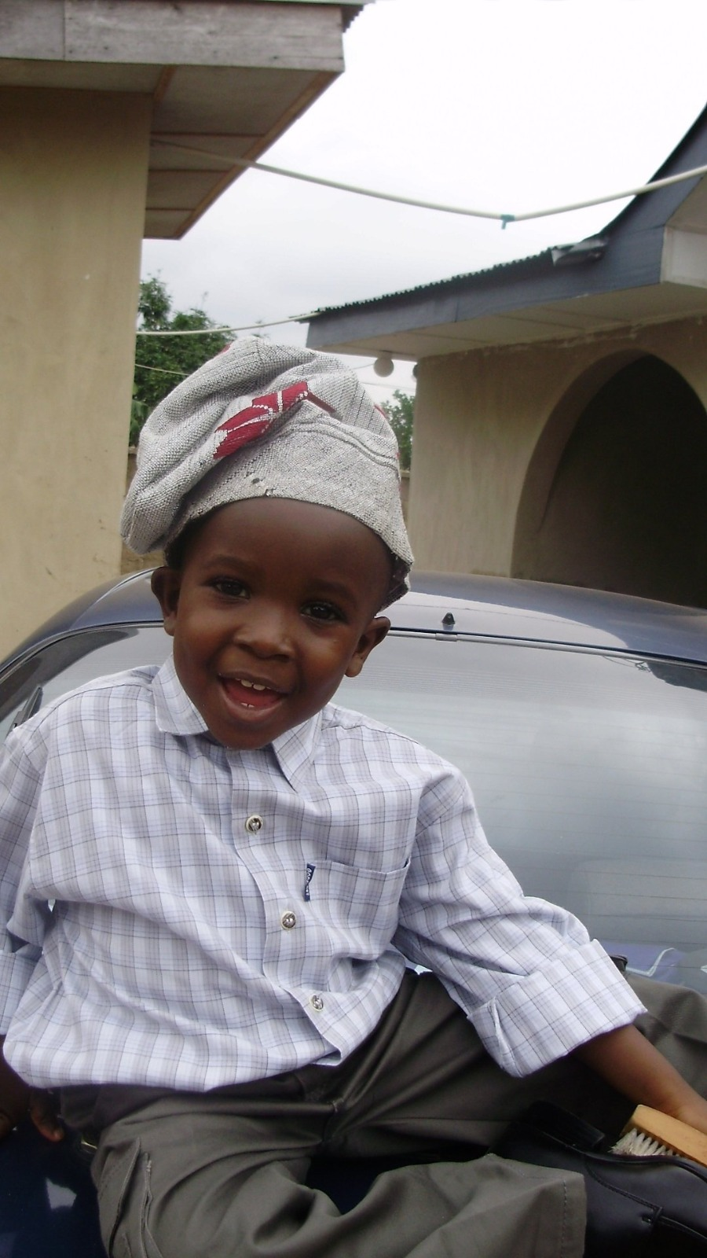

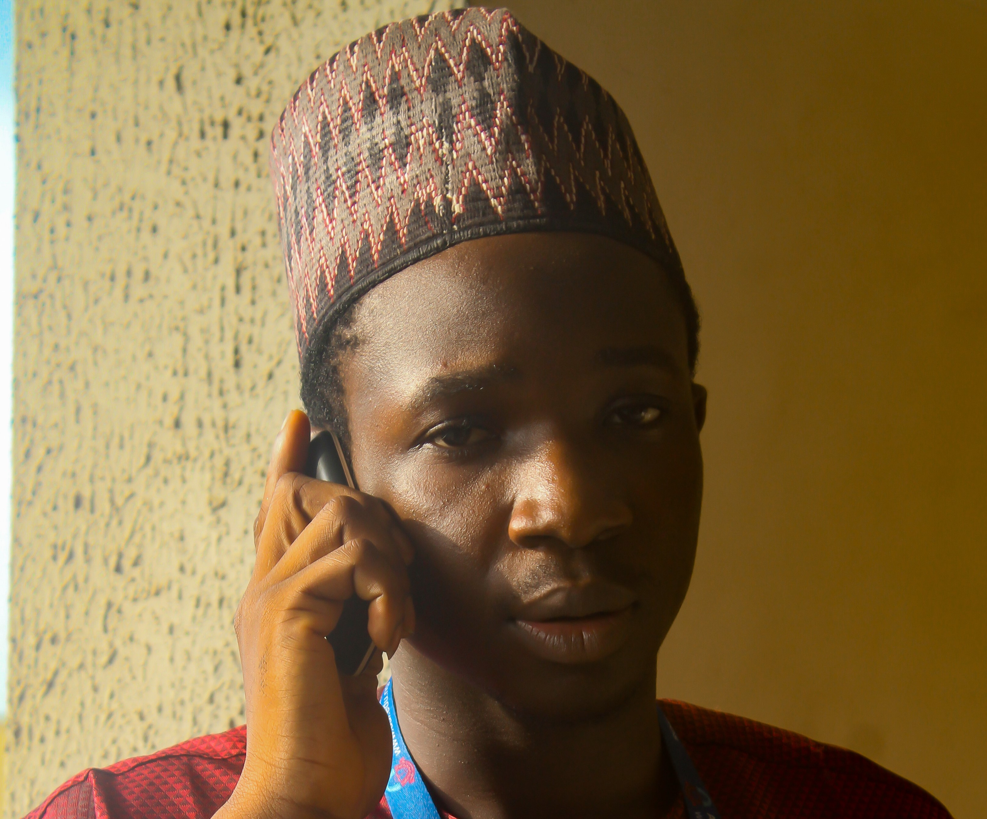

Slide 13



Slide 14
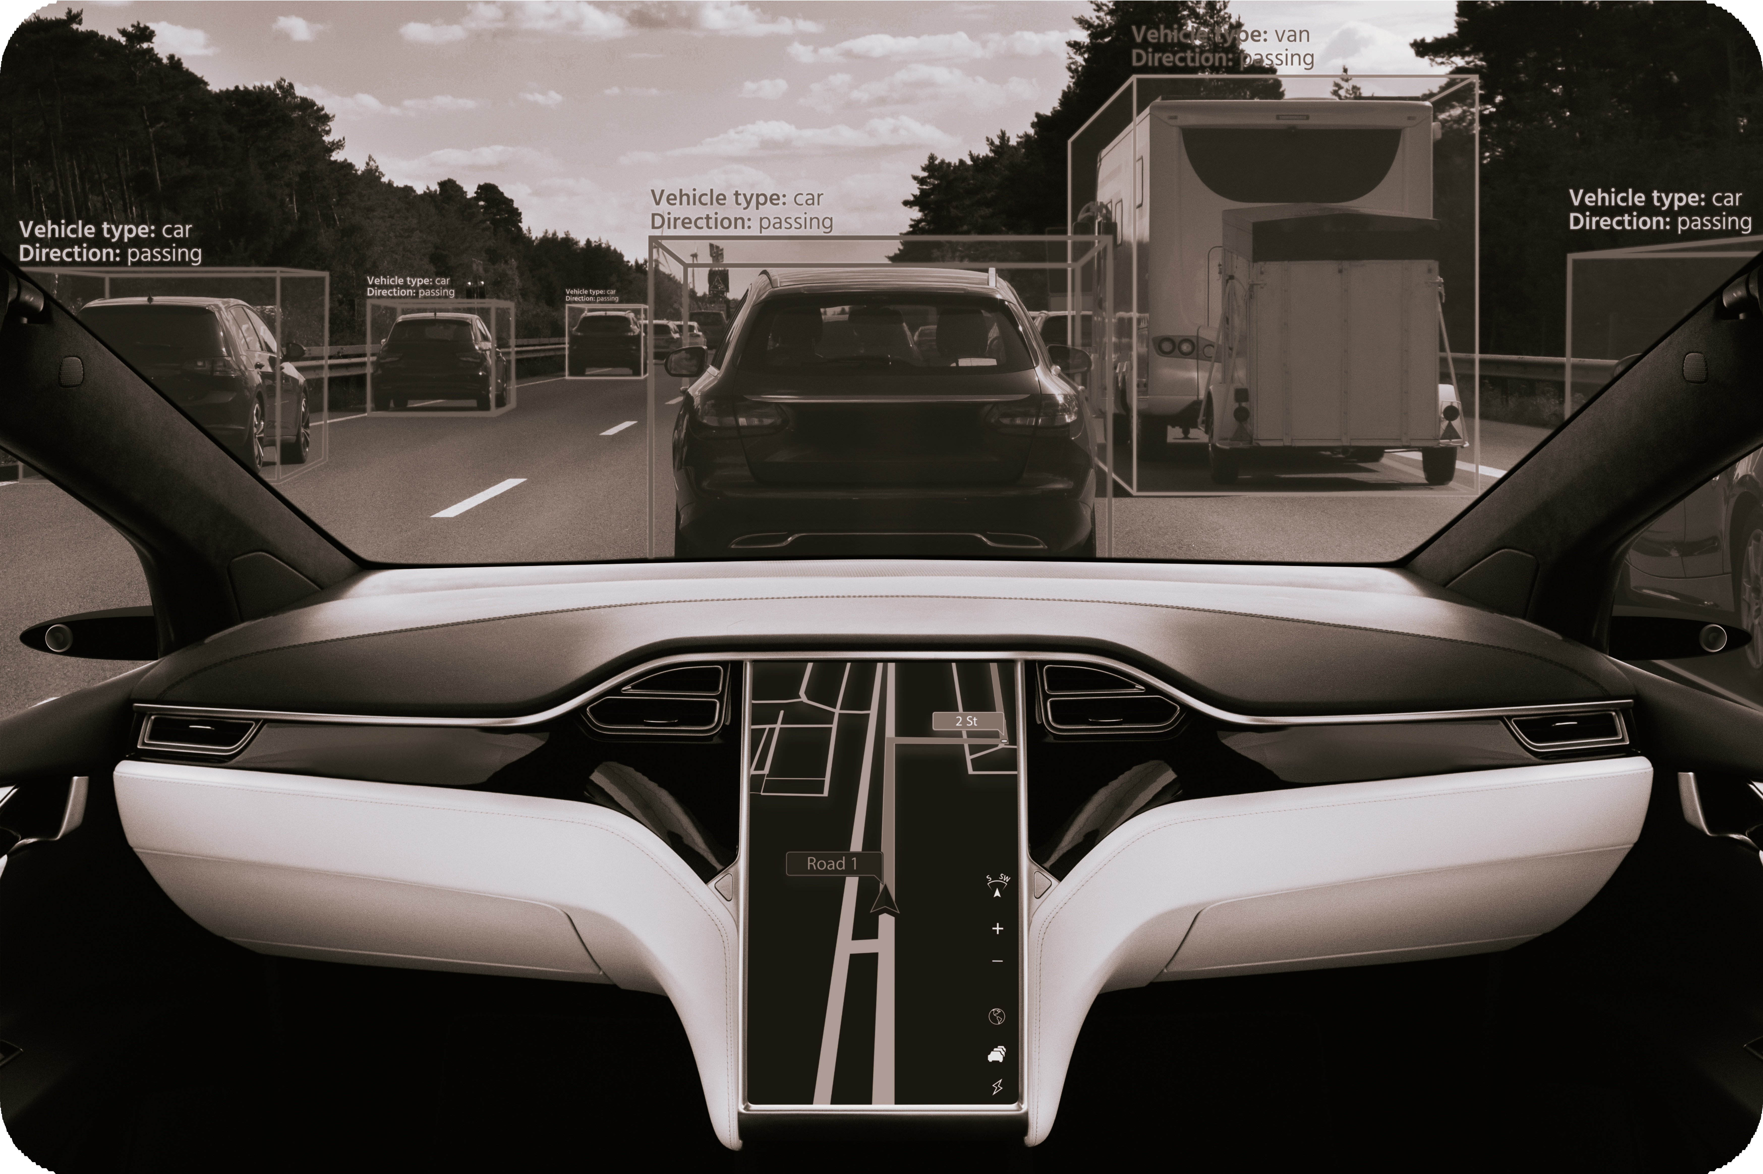
Core Architectures: CNN Mechanics
Convolutional Layers: Local Pattern Detection
Extract edges, textures, and shapes using learnable ﬁlters.
Pooling Layers: Enhancing Efﬁciency
Reduce spatial dimensions and computation while retaining key features.
Fully Connected Layers: Final Classiﬁcation
Transform extracted features into class predictions.
Residual Networks: Solving Vanishing Gradients
Skip connections enable deeper, more accurate models.
What are CNNs?
CNNs are biologically inspired architectures designed to process grid-like data. They rely on the concept of local receptive fields and weight sharing.
Notes:
CNNs work through local pattern detection. Convolutional layers use filters to find edges and textures. Pooling layers then shrink the image to make the system more efficient. Finally, dense layers turn those features into a class prediction, like 'Car' or 'Person'.

Slide 15

Core Architectures: Vision Transformers
Global Context with
Self-Attention
Vision Transformers analyze all image regions simultaneously.
Image Patching and Embedding
Images are split into ﬁxed-size patches, each converted into a vector.
Self-Attention Across the
Image
Captures relationships between distant patches for holistic understanding.
Notes:
Vision Transformers (ViTs) represent a paradigm shift. Instead of local filters, they split images into patches and use 'Self-Attention'. This allows the model to analyze all image regions simultaneously, capturing global context that CNNs might miss

Slide 16
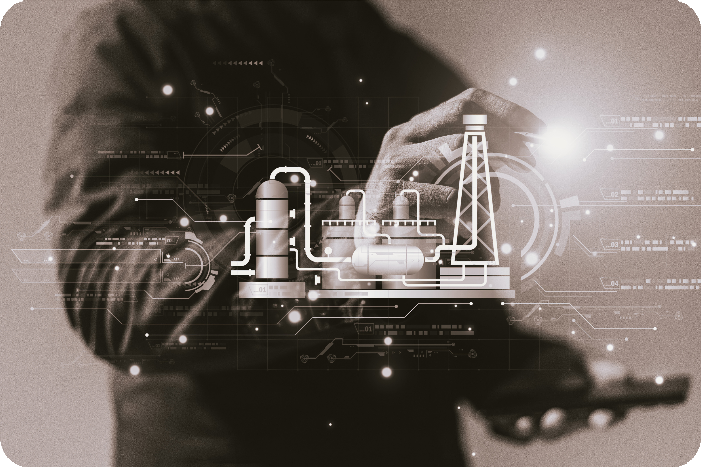
Comparing CNNs and Vision Transformers
CNNs: Local Pattern Experts
Leverage strong inductive bias for spatial locality
Perform efﬁciently on smaller datasets
Vision Transformers: Global Context Masters
Utilize self-attention for immediate global receptive ﬁeld
Require large-scale data for optimal performance
Robustness to Occlusion
ViTs excel at recognizing partially hidden objects
Notes:
How do they compare? CNNs are 'Local Pattern Experts' and work well on smaller datasets. ViTs are 'Global Context Masters'. One major advantage for ViTs is their robustness to occlusion—they are much better at recognizing an object even if it is partially hidden

Slide 17
State-of-the-Art and Applications

Slide 18
State-of-the-Art: YOLOv11 and SAM 2
Model | Key Feature | Advantage
YOLOv11 | Real-time object detection | Single regression, high speed
YOLOv11 | 22% fewer parameters vs YOLOv8 | Efﬁcient for edge deployment
YOLOv11 | Higher precision (mAP) | Improved accuracy in cluttered scenes
SAM 2 | Memory bank for video | Tracks objects across frames
SAM 2 | Promptable segmentation | Interactive via clicks, boxes, or text
Notes:
In 2025, YOLOv11 is the gold standard for speed, using 22% fewer parameters than YOLOv8 to achieve higher precision on edge devices. For segmentation, Meta's SAM 2 uses a 'memory bank' to track objects across video frames consistently, even during occlusions

Slide 19

Applications: Healthcare and Transport
Medical Imaging: Enhanced Diagnostics
AI models detect tumors in MRI and CT scans with high accuracy.
Computer vision guides surgeons during complex procedures.
Autonomous Vehicles: Real-Time Perception
Semantic segmentation distinguishes roads, obstacles, and pedestrians.
3D tracking predicts object movement for collision avoidance.
Systems process visual data at 30+ frames per second.
Notes:
In healthcare, CV guides surgeons and detects tumors in MRIs with high accuracy . In transport, autonomous vehicles use semantic segmentation to distinguish roads from pedestrians in real-time, often processing data at over 30 frames per second to ensure safety

Slide 20


Applications: Retail, Industry, Agriculture
Retail: Enhancing Customer Experience
Heatmaps track shopper movement and dwell time
Facial recognition enables seamless checkout
Manufacturing: Quality Assurance
Automated defect detection ensures product reliability
Agriculture: Precision Monitoring
Drones analyze crop health and optimize irrigation
Notes:
Other industries are following suit. Drones optimize irrigation in agriculture , automated systems catch defects in manufacturing , and retail stores use heatmaps to track how shoppers move through aisles.

Slide 21
Challenges, Ethics, and Conclusion

Slide 22
Technical and Computational Challenges
Detecting Small
Objects
Adapting to Lighting & Scale
Edge Device
Limitations
Real-Time Processing Demands
Standard models often miss tiny or distant items in images.
Shadows, glare, and size changes challenge model accuracy.
Limited memory and processing power restrict model complexity.
Inference must be fast—often under 33ms for safety-critical tasks.
Notes:
Despite the progress, we face hurdles. Real-time inference must happen under 33 milliseconds for safety. We also struggle with edge device limitations and the difficulty of detecting very small or distant objects in high-resolution frames

Slide 23

Privacy, Ethics, and Future Trends
Ethical Challenges in Computer Vision
Bias in facial recognition can lead to unfair outcomes.
The Black Box Problem
Lack of explainability raises trust and accountability issues.
Emerging Trends and Solutions
Multimodal models combine vision with language for richer understanding.
Efﬁcient AI: quantization and pruning enable mobile deployment.
Notes:
Ethics is our final frontier. We must address bias in facial recognition and the 'Black Box' problem—the lack of explainability in how these models make decisions . The future lies in Multimodal models that combine sight with language for a richer understanding

Slide 24
Conclusion and References
From Early Algorithms to Industry Impact
Key References for Further Study
Open for Questions and Discussion
Computer Vision has evolved from simple pattern recognition to powering real-world applications in healthcare, transport, retail, and agriculture.
IBM Research: What Is Computer Vision?
AWS: Image Recognition AI/ML
OpenCV: Beginner's Guide 2025
Ultralytics: Vision AI History
We welcome your insights and queries on the future of Computer Vision.
Notes:
In conclusion, we have moved from simple pattern recognition to a technology that powers global industries. We’ve included key references from IBM, AWS, and OpenCV for further study . Thank you for your time, we are now open for questions

